Slide 1
Competitors
My Study Life – School Planner
QUT Blackboard / Virtual
Microsoft Outlook
Google Calendar
Assignment Calculator

Slide 2
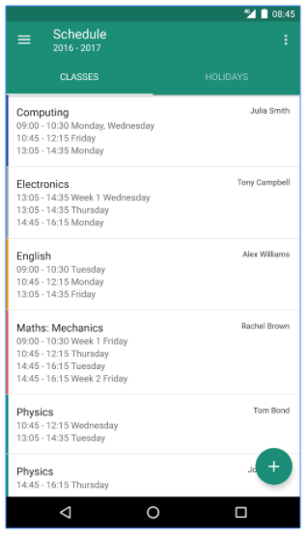
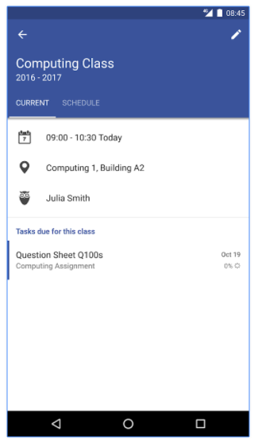
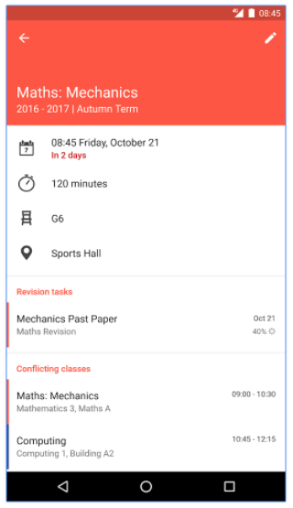
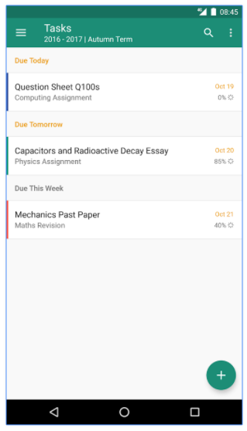
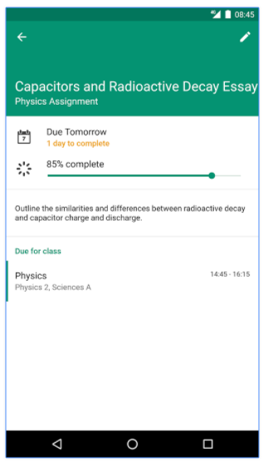
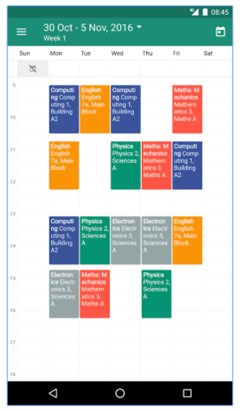
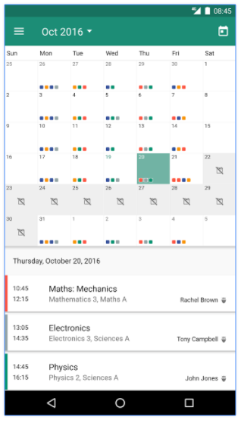
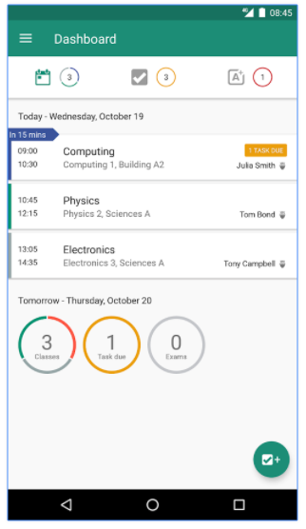
My Study Life – School Planner
Pros:
Allows adding of classes, homework, assignments, exams, holidays, and term lengths
Has a clear view of timetable
Allows dedication of time to exam revision
Allows offline entering of data
Syncs to a desktop application
Cons:
No option to include non-study related tasks (e.g. house duties, work deadlines, personal responsibilities or commitments)
No ability to work on group projects
No ability to set tasks for group members
No reminders for tasks that have deadlines
No priority setting for tasks

Slide 3
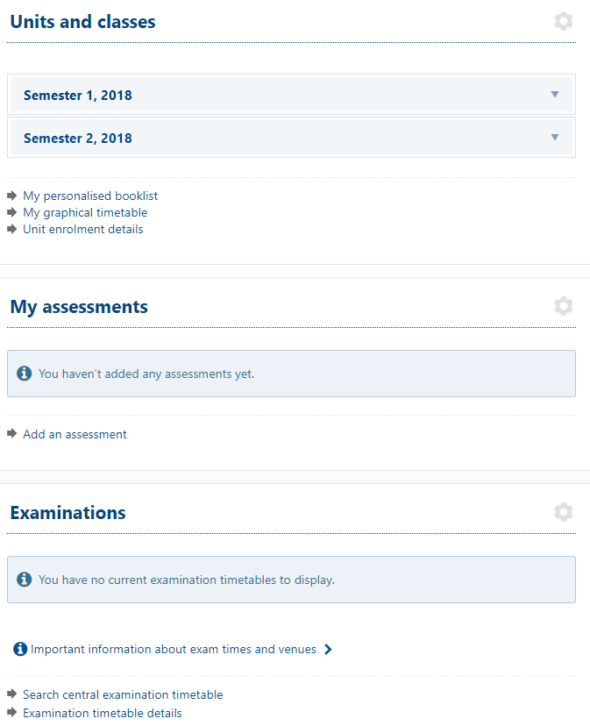
QUT Blackboard / Virtual
Pros:
Displays timetable, exams, and assignments in list format
Can add assignments
Very good with unit information retrieval
Substantially reliable
All data is synced and no data about exams, assignments or timetables can be lost
Assignments are listed according to priority (due date)
Cons:
Inability to see timetable, exams, and assignments in month, week, or day format
Exams and units can’t be added
Units don’t link assignment details to the assignment section
Reminders of due assignments aren’t sent out
Planning of group assignments and homework can’t be done
Not very user friendly when trying to manage study and groups in classes
No calendar view

Slide 4
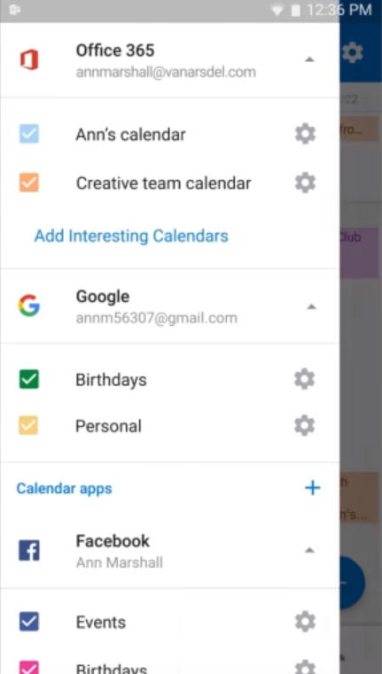
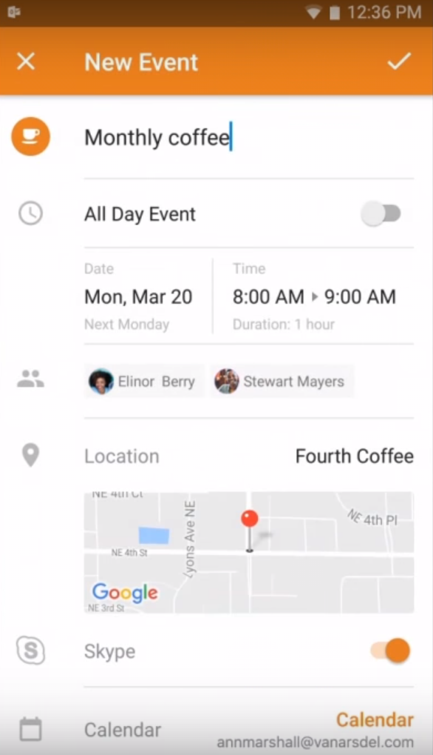
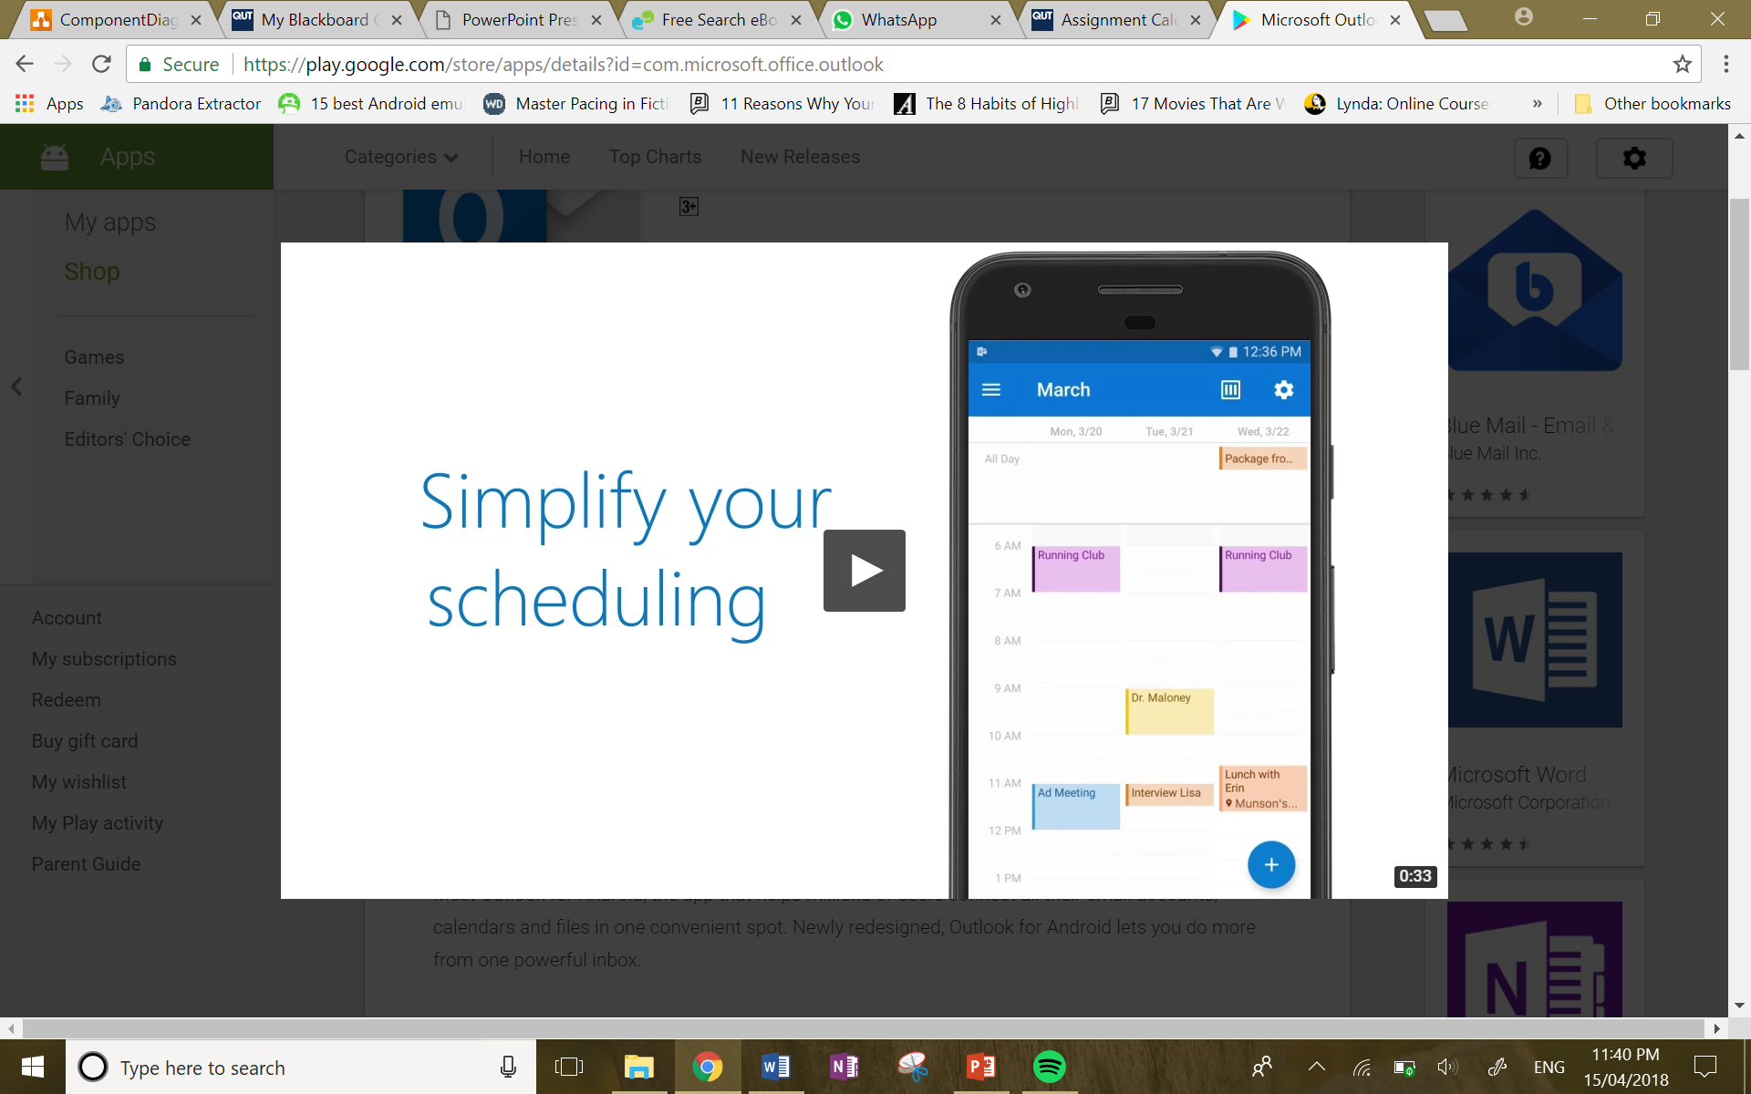
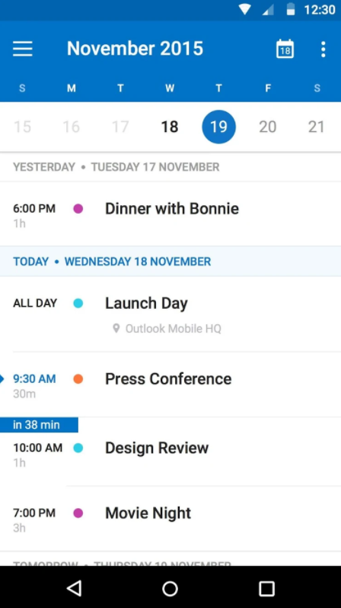
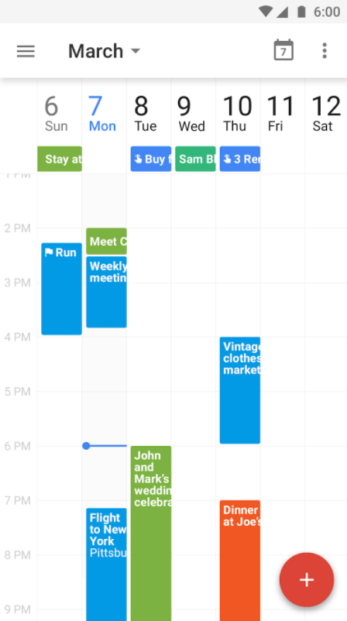
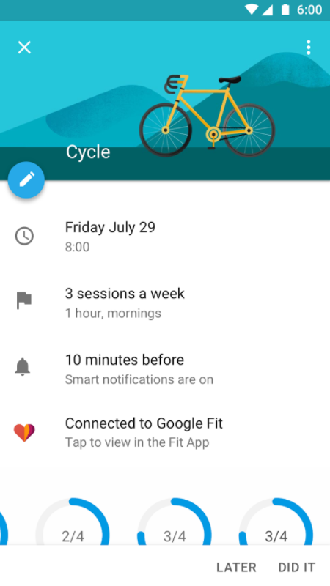
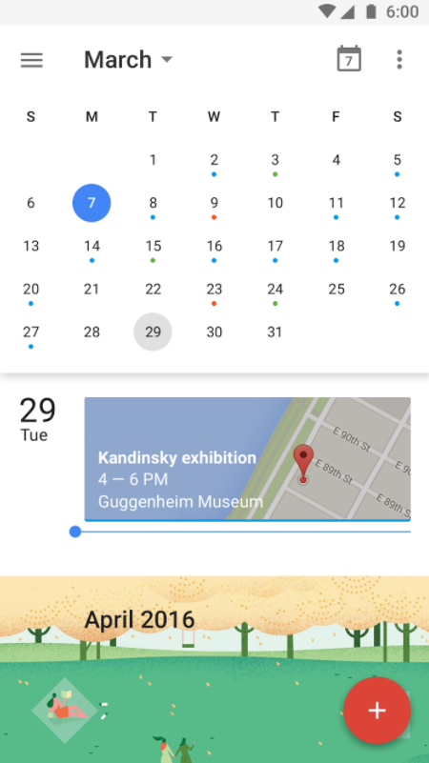
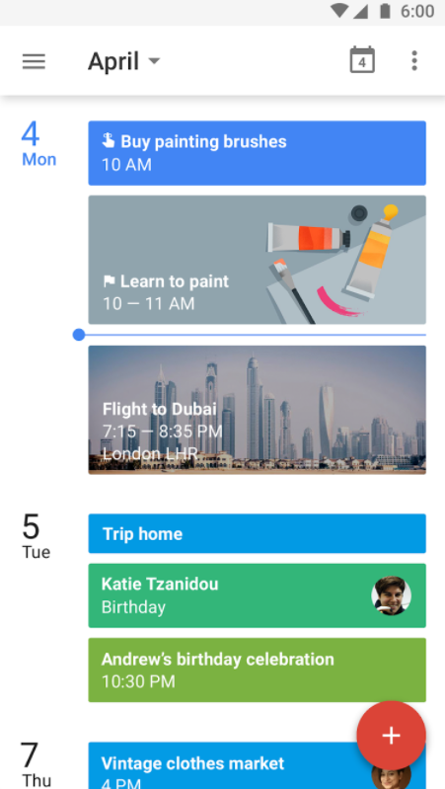
Microsoft Outlook & Google Calendar
Pros:
Can add tasks, goals, assignments, exams and any other commitments
Can invite group members to events
Reminders can be set for tasks, events ,and goals
Is a very simple, easy to follow layout
Data is always synced = no data loss
Has flexible calendar viewings (month, week, day, schedule)
Can get accurate locations for events (Google Maps)
Cons:
No prioritisation of tasks, events ,or goals
No ability to compare calendars with others
By default, reminders aren’t set for each task, event, and goal

Slide 5
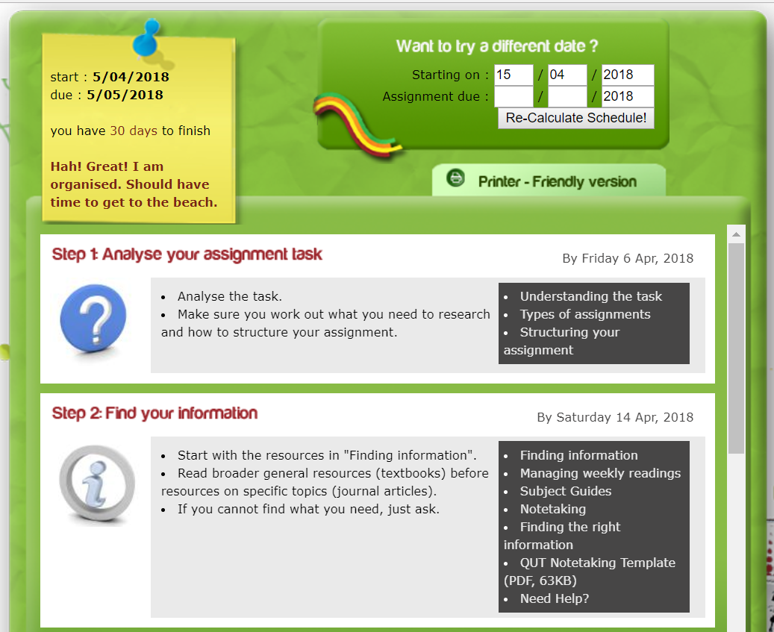

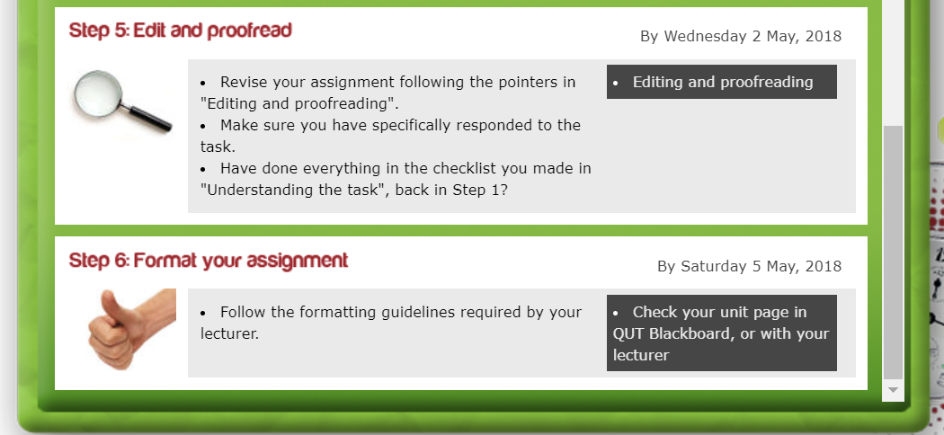
Assignment Calculator
Pros:
Has great organisation for assignment planning
Has a detailed to do list for a particular assignment
Very reliable – web based
Sorts tasks to do for assignment according to priority
Cons:
No focus on timetables, exams, or calendar views
No reminders for assignment steps
No ability to add external tasks
No ability to collaborate with group members
No ability to set tasks for other people

Slide 6
Comparison of Competitors

